Slide 1
Kunisch Recognition through Multi-Label Classification Algorithms
Prof. Benjamín Bustos
Prof. Iván Sipirán
Matías Vergara

Slide 2
1. Introduction
Ornamente Geometrischer Vasen: Ein Kompendium¹ is a collection of patterns present on archaeological objects, each of which is tagged with a set of labels.
¹Norbert Kunisch, 1998
²

Slide 3
1. Introduction
Ornamente Geometrischer Vasen: Ein Kompendium¹ is a collection of patterns present on archaeological objects, each of which is tagged with a set of labels.
This work seeks to apply multi-label classification algorithms on them, in order to develop a tool that serves for the labeling of new entries in the future.
¹Norbert Kunisch, 1998
³

Slide 4
2. Data Extraction
In order to conduct such experiments, it was first necessary to get a usable version of the labels and a descriptor for each pattern.
⁴

Slide 5
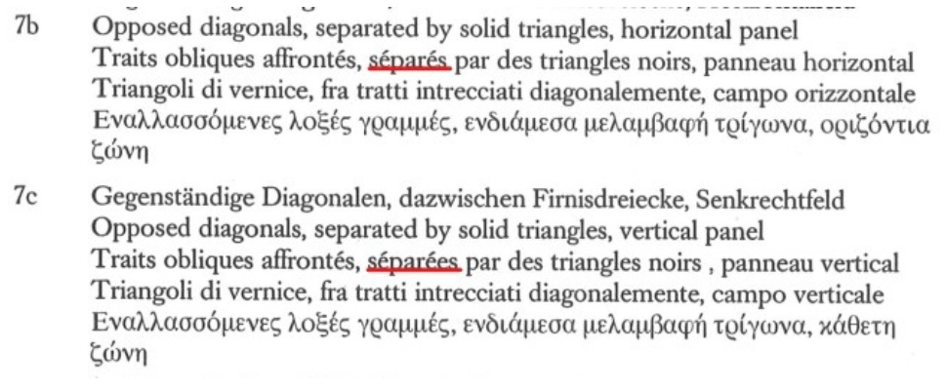
2. Data Extraction
In order to conduct such experiments, it was first necessary to get a usable version of the labels and a descriptor for each pattern.
For the labels:
We decided to use the English version of them, due to some good properties of the language (such as gender neutrality).
Labels were extracted manually.
Fig 1. Labels of patterns 7b and 7c
⁵

Slide 6
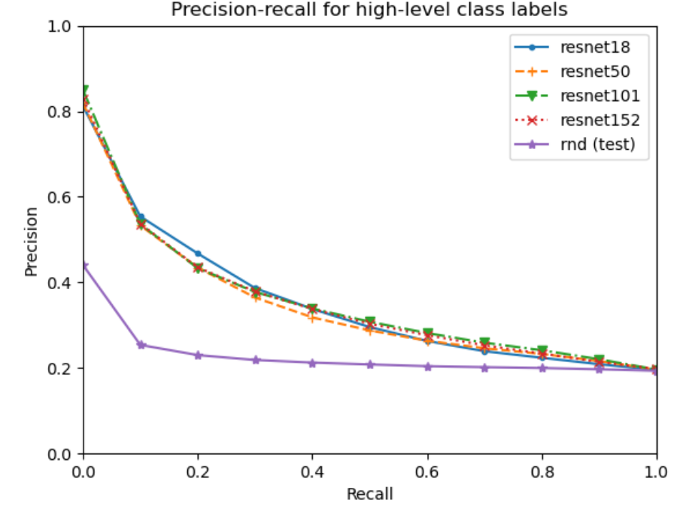
2. Data Extraction
In order to conduct such experiments, it was first necessary to get a usable version of the labels and a descriptor for each pattern.
For the descriptors:
We conducted experiments testing ResNet architectures and a Random Neural Network in the task of classifying patterns in their high-level classes (chapter of the book).
We decided to use ResNet18 features as descriptors for the patterns, and we also took the ones from ResNet50 in order to have an option to compare with.
Fig 2. Precision-recall for high-level class labels
⁶

Slide 7
3. Data Exploration
Once we had the data, we did an exploratory analysis to determine its principal properties. We discovered two main issues.
⁷

Slide 8
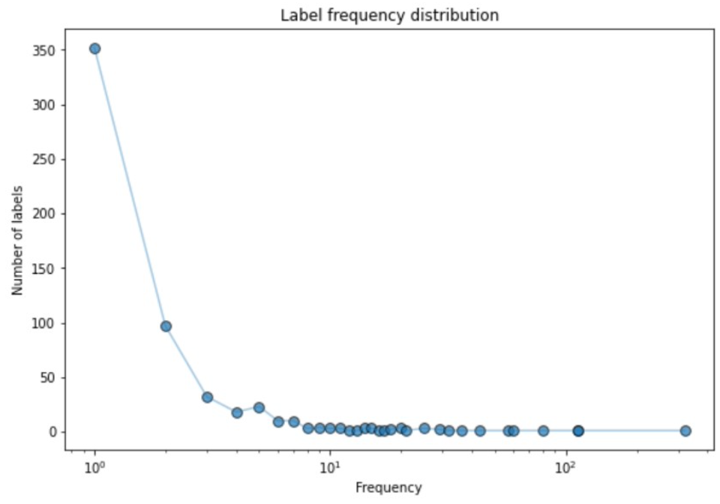
3. Data Exploration
Once we had the data, we did an exploratory analysis to determine its principal properties. We discovered two main issues.
Too many labels with low number of events in the data:
For low numbers of events there are many labels, while for high occurrences there are very few labels.
Zipf-like distribution?
Fig 3. Label frequency distribution
⁸

Slide 9
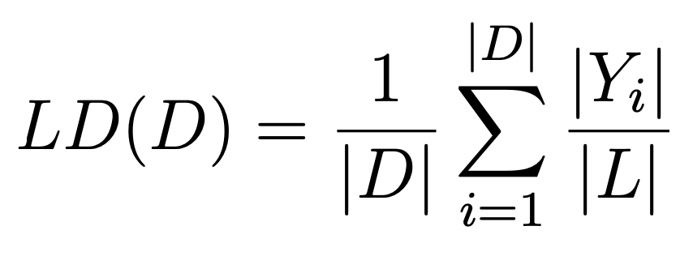
3. Data Exploration
Once we had the data, we did an exploratory analysis to determine its principal properties. We discovered two main issues.
Consequently, an extremely low label density²:
Relation between the number of samples and labels related to each of them.
In our case, this measure takes a value of 0.005, extremely low.
This is not surprising, however, since label cardinality (average number of labels per example) is very low relative to the total of labels (4 vs 586).
²Tsoumakas G., Katakis I., V. I., “A review of multi-label classification methods,” International Journal of Data Warehousing and Mining, vol. 3, pp. 1–13, 2007.
⁹

Slide 10
4. Proposed Methods
We decided to address the problem from two of the approaches most recommended by the literature.
¹⁰

Slide 11
4. Proposed Methods
We decided to address the problem from two of the approaches most recommended by the literature.
Through Problem Transformation Methods:
Binary Relevance
Power Labelset
Classifier Chain
Distinct Random k-Labelsets (RakELD)
¹¹

Slide 12
4. Proposed Methods
We decided to address the problem from two of the approaches most recommended by the literature.
Through Problem Transformation Methods:
Binary Relevance
Power Labelset
Classifier Chain
Distinct Random k-Labelsets (RakELD)
Through Algorithm Adaptation Methods:
Multilabel k-Nearest Neighbors (MLkNN)
Twin Multi-label Support Vector Machines (MLTSVM)
Binary Relevance K-Nearest Neighbors (BRkNN)
¹²

Slide 13
5. Metrics
Finally, it is important to pay attention to which metrics will we use to compare results, since the evaluation of a multi-label classification algorithm includes an additional notion of being partially correct.
¹³

Slide 14
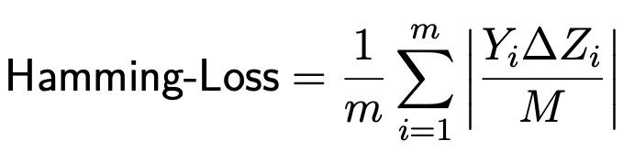
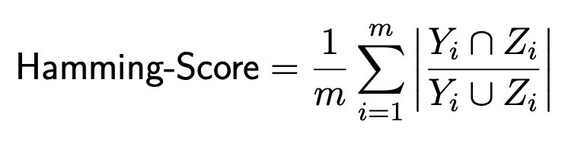
5. Metrics
Finally, it is important to pay attention to which metrics will we use to compare results, since the evaluation of a multi-label classification algorithm includes an additional notion of being partially correct.
We decided to use 3 metrics:
Exact Match Ratio
Hamming Loss
Hamming Score (also knew as label-based accuracy).
¹⁴

Slide 15
6. Pruning Strategy
To treat the issues related to the problem’s label density, we adopted a problem pruning approach.
¹⁵

Slide 16
6. Pruning Strategy
To treat the issues related to the problem’s label density, we adopted a problem pruning approach.
We prune the labels based on their number of events in the data set. We then apply and compare methods at different levels of pruning.
¹⁶

Slide 17
6. Pruning Strategy
To treat the issues related to the problem’s label density, we adopted a problem pruning approach.
We prune the labels based on their number of events in the data set. We then apply and compare methods at different levels of pruning.
The more we prune, the easier the problem… But it also becomes less interesting.
¹⁷

Slide 18
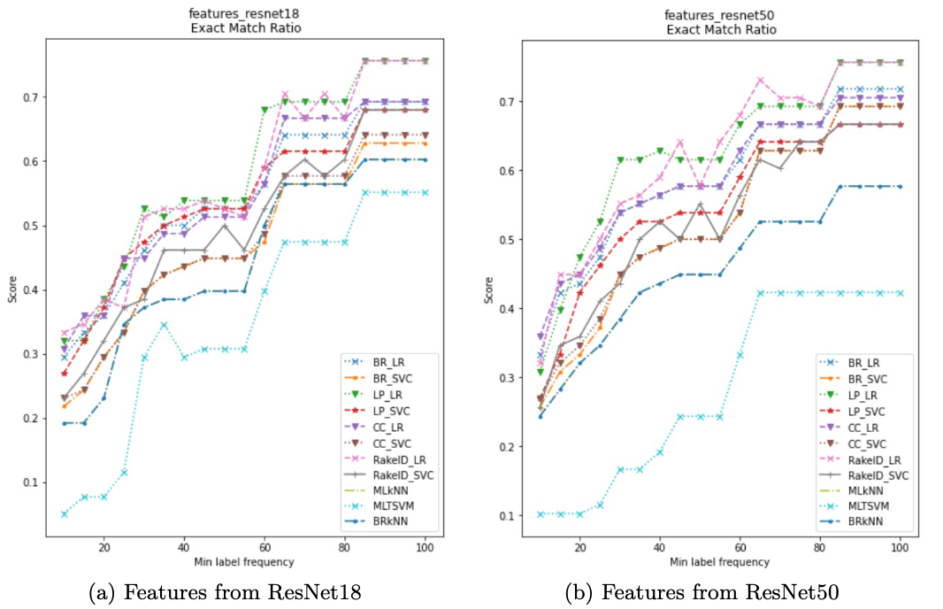
7. Results
Fig 4. Exact Match Ratio
¹⁸

Slide 19
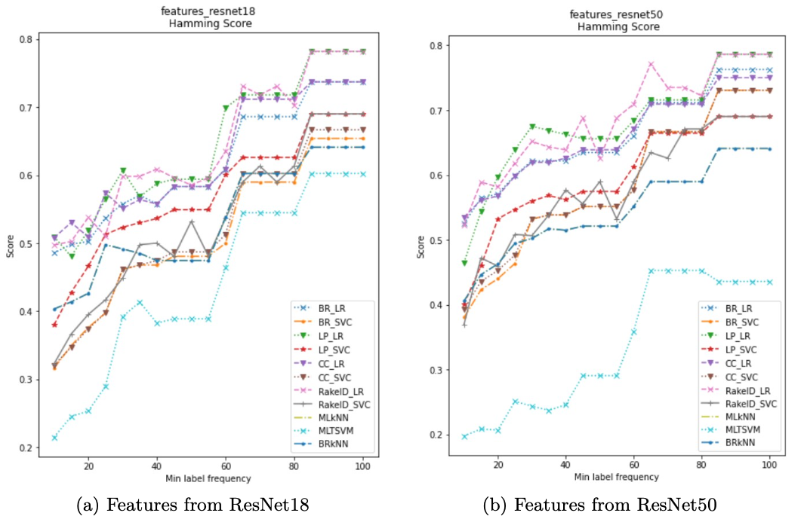
7. Results
Fig 5. Hamming Score
¹⁹

Slide 20
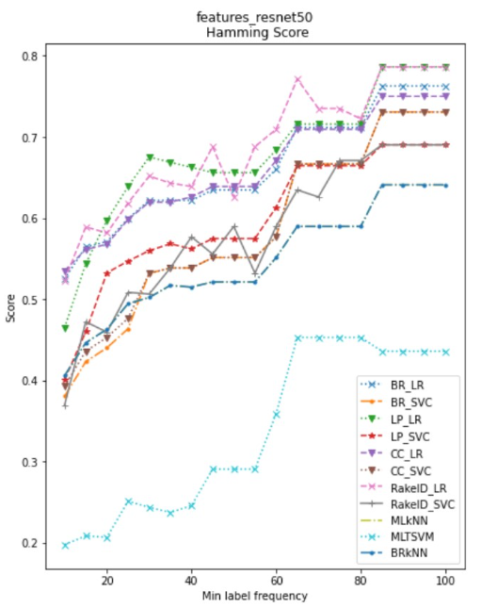
8. Discussion
Firstly, we note that as we move along the abscissa, the methods tend to give better results.
Fig 5b. Hamming Score with
ResNet50 features
²⁰

Slide 21
8. Discussion
Firstly, we note that as we move along the abscissa, the methods tend to give better results.
This is reasonable: the higher the threshold, less labels to predict, and more examples per label.
Fig 5b. Hamming Score with
ResNet50 features
²¹

Slide 22
8. Discussion
Firstly, we note that as we move along the abscissa, the methods tend to give better results.
This is reasonable: the higher the threshold, less labels to predict, and more examples per label.
We also note that the Problem Transformation Methods give better results than Algorithm Adaptation ones.
Fig 5b. Hamming Score with
ResNet50 features
²²

Slide 23
8. Discussion
We also observe that ResNet50 descriptors gives rise to better results than the ones from ResNet18.
Fig 5b. Hamming Score with
ResNet50 features
²³

Slide 24
8. Discussion
We also observe that ResNet50 descriptors gives rise to better results than the ones from ResNet18.
This is especially noticeable for low threshold values.
Fig 5b. Hamming Score with
ResNet50 features
²⁴

Slide 25
8. Discussion
We also observe that ResNet50 descriptors gives rise to better results than the ones from ResNet18.
This is especially noticeable for low threshold values.
We want to keep the problem as interesting as possible, i.e., use the lowest threshold possible.
Fig 5b. Hamming Score with
ResNet50 features
²⁵

Slide 26
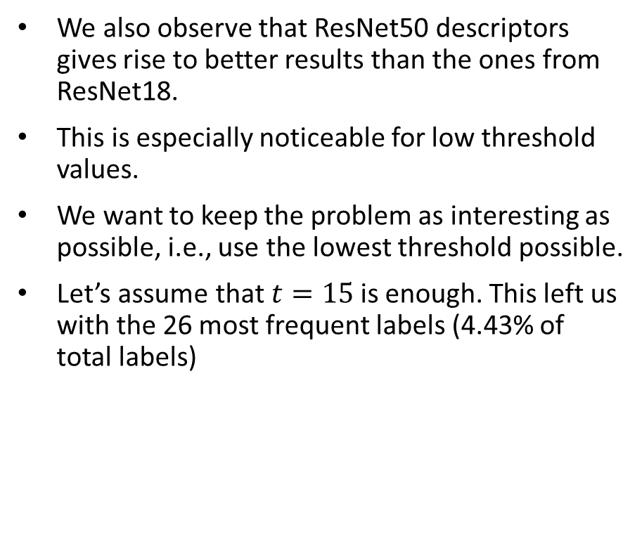
8. Discussion
We also observe that ResNet50 descriptors gives rise to better results than the ones from ResNet18.
This is especially noticeable for low threshold values.
We want to keep the problem as interesting as possible, i.e., use the lowest threshold possible.
Let’s assume that $t=15$is enough. This left us with the 26 most frequent labels (4.43% of total labels)
Fig 5b. Hamming Score with
ResNet50 features
²⁶

Slide 27
8. Discussion
In this situation, we notice that some methods stand out above the rest.
Fig 5b. Hamming Score with
ResNet50 features
²⁷

Slide 28
8. Discussion
In this situation, we notice that some methods stand out above the rest.
These are, in decreasing order, RakelD_LR, CC_LR, BR_LR and LP_LR.
Fig 5b. Hamming Score with
ResNet50 features
²⁸

Slide 29
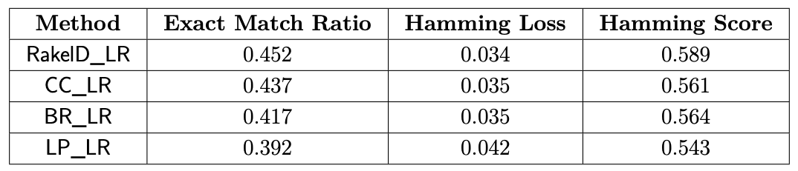
8. Discussion
In this situation, we notice that some methods stand out above the rest.
These are, in decreasing order, RakelD_LR, CC_LR, BR_LR and LP_LR.
Fig 5b. Hamming Score with
ResNet50 features
²⁹

Slide 30
8. Discussion
In this situation, we notice that some methods stand out above the rest.
These are, in decreasing order, RakelD_LR, CC_LR, BR_LR and LP_LR.
From all of them, RakelD_LR obtains the best results for all metrics.
Fig 5b. Hamming Score with
ResNet50 features
³⁰

Slide 31
8. Discussion
In this situation, we notice that some methods stand out above the rest.
These are, in decreasing order, RakelD_LR, CC_LR, BR_LR and LP_LR.
From all of them, RakelD_LR obtains the best results for all metrics.
It is then reasonable to study it’s results in depth.
Fig 5b. Hamming Score with
ResNet50 features
³¹

Slide 32
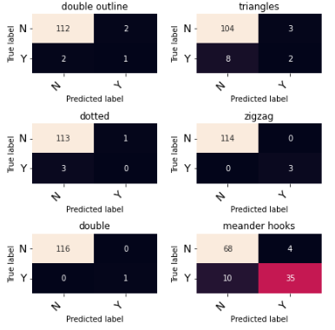
8. Discussion
To get a better understanding of the results, we study them through confusion matrices.
Fig 6. RakelD confusion matrices at t=15 (extract)
³²

Slide 33
8. Discussion
To get a better understanding of the results, we study them through confusion matrices.
We note that approximately 95% of classifications fall into true negatives.
Fig 6. RakelD confusion matrices at t=15 (extract)
³³

Slide 34
8. Discussion
To get a better understanding of the results, we study them through confusion matrices.
We note that approximately 95% of classifications fall into true negatives.
This shows an exaggerated disproportion between negative and positive cases for each label. We assume this happens both in test and training.
Fig 6. RakelD confusion matrices at t=15 (extract)
³⁴

Slide 35
8. Discussion
To get a better understanding of the results, we study them through confusion matrices.
We note that approximately 95% of classifications fall into true negatives.
This shows an exaggerated disproportion between negative and positive cases for each label. We assume this happens both in test and training.
As consequence, the algorithm is managing to learn correctly when a pattern should not be tagged with a certain label, but not in the opposite case: when the label correspond to that pattern.
Fig 6. RakelD confusion matrices at t=15 (extract)
³⁵

Slide 36
8. Discussion
There are many possible reasons for this:
The already mentioned low label density,
A poor construction of training and test set.
Fig 6. RakelD confusion matrices at t=15 (extract)
³⁶

Slide 37
8. Discussion
There are many possible reasons for this:
The already mentioned low label density,
A poor construction of training and test set.
However, since we know that label density is extremely low, we can assume that the difficult lies there. This way, the problem is in the data set itself.
Fig 6. RakelD confusion matrices at t=15 (extract)
³⁷

Slide 38
8. Discussion
There are many possible reasons for this:
The already mentioned low label density,
A poor construction of training and test set.
However, since we know that label density is extremely low, we can assume that the difficult lies there. This way, the problem is in the data set itself.
Too many labels, and only a few of them for each pattern.
As consequence, too many negative examples, very few positives.
Fig 6. RakelD confusion matrices at t=15 (extract)
³⁸

Slide 39
8. Discussion
There are many possible reasons for this:
The already mentioned low label density,
A poor construction of training and test set.
However, since we know that label density is extremely low, we can assume that the difficult lies there. This way, the problem is in the data set itself.
Too many labels, and only a few of them for each pattern.
As consequence, too many negative examples, very few positives.
Fig 6. RakelD confusion matrices at t=15 (extract)
…But there are some steps that we can take to deal with it.
³⁹

Slide 40
9. Future work
We detected that one way to improve the data set is by homogenizing the labels. This to treat some undesirable cases:
Labels with stop words, such as “as filling ornament”
Patterns with plural labels, which do not include individual ones. For example, patterns with the label “triangles” but not with “triangle”.
⁴⁰

Slide 41
9. Future work
We detected that one way to improve the data set is by homogenizing the labels. This to treat some undesirable cases:
Labels with stop words, such as “as filling ornament”
Patterns with plural labels, which do not include individual ones. For example, patterns with the label “triangles” but not with “triangle”.
In this regard, we consider that stemming or lemmatisation could be good alternatives to deal with this problem from an algorithmic approach.
However, it is also recommended to include the opinion of experts, to understand what characteristics of the labeling we should respect and which we can modify.
⁴¹

Slide 42
9. Future work
We detected that one way to improve the data set is by homogenizing the labels. This to treat some undesirable cases:
Labels with stop words, such as “as filling ornament”
Patterns with plural labels, which do not include individual ones. For example, patterns with the label “triangles” but not with “triangle”.
In this regard, we consider that stemming or lemmatisation could be good alternatives to deal with this problem from an algorithmic approach.
However, it is also recommended to include the opinion of experts, to understand what characteristics of the labeling we should respect and which we can modify.
This way we could reduce the number of single-event labels, as well as increasing the number of labels per pattern.
⁴²

Slide 43
10. Conclusions
The work carried out gives rise to several conclusions. between them we have:
⁴³

Slide 44
10. Conclusions
The work carried out gives rise to several conclusions. between them we have:
The superiority of ResNet50 descriptors over the ones from ResNet18.
This also leaves a question: will we still have better results if we increase the dimensionality? Up to what point?
⁴⁴

Slide 45
10. Conclusions
The work carried out gives rise to several conclusions. between them we have:
The superiority of ResNet50 descriptors over the ones from ResNet18.
This also leaves a question: will we still have better results if we increase the dimensionality? Up to what point?
Problem Transformation Methods over Algorithm Adaptation ones.
Again, with the conclusion comes the question: why does this phenomenon happen? Which feature of the data set is best covered by the problem transformation?
⁴⁵

Slide 46
10. Conclusions
The work carried out gives rise to several conclusions. between them we have:
The superiority of ResNet50 descriptors over the ones from ResNet18.
This also leaves a question: will we still have better results if we increase the dimensionality? Up to what point?
Problem Transformation Methods over Algorithm Adaptation ones.
Again, with the conclusion comes the question: why does this phenomenon happen? Which feature of the data set is best covered by the problem transformation?
The need to define to what level we will prune the problem.
Bearing in mind that the more we prune, the easier the problem is… But less useful as well.
⁴⁶

Slide 47
10. Conclusions
The work carried out gives rise to several conclusions. between them we have:
The superiority of ResNet50 descriptors over the ones from ResNet18.
This also leaves a question: will we still have better results if we increase the dimensionality? Up to what point?
Problem Transformation Methods over Algorithm Adaptation ones.
Again, with the conclusion comes the question: why does this phenomenon happen? Which feature of the data set is best covered by the problem transformation?
The need to define to what level we will prune the problem.
Bearing in mind that the more we prune, the easier the problem is… But less useful as well.
Investigate techniques and apply them to labels in order to improve the data set.
We need to increase the label density to get better results.
⁴⁷

Slide 48
Kunisch Recognition through Multi-Label Classification Algorithms
Prof. Benjamín Bustos
Prof. Iván Sipirán
Matías Vergara

Slide 49
Hamming-Loss
Hamming Loss takes into account prediction errors (incorrect label) and missing errors (label not predicted). Then, Hamming Loss evaluates the frequency that an example-label pair is misclassified, i.e., an example is associated to the wrong label or a label belonging to the instance is not predicted
Where ∆ stands for the symmetric difference of two sets, which is the set-theoretic equivalent of the exclusive disjunction (XOR operation) in Boolean logic
The fraction of the wrong labels to the total number of labels.
^{A1}

Slide 50
Hamming-Score
Defined as the proportion of the predicted correct labels to the total number (predicted and actual) of labels for that instance. Overall Hamming Score is the average across all instances.
^{A2}

Slide 51
Label Density
Density of a multi-label dataset is the mean of the number of labels of the instances that belong to the dataset divided by the number of dataset’s labels.
^{A3}

Slide 52
Algorithm Adaptation Methods
MLkNN builds uses k-NearestNeighbors to find nearest examples to a test class and uses Bayesian inference to select assigned labels.
MLTSVM determines multiple nonparallel hyperplanes to capture the multi-label information embedded in data.
K-Neighbors Binary Relevance is a Binary Relevance multi-label classifier based on k-Nearest Neighbors method. The used version of the classifier assigns the most popular m labels of the neighbors, where m is the average number of labels assigned to the object’s neighbors.
^{A4}

